Slide 1
The
Native Americans Unit
Investigative Question: How did location and physical geography influence the daily life of each American Indian tribe?

Slide 2
I will also be able to:
Differentiate between primary and secondary sources.
Distinguish fact from fiction by comparing documentary sources on historical figures and events with fictionalized characters and events.

Slide 3
The
Native Americans Unit
Investigative Question: How did location and physical geography influence the daily life of each American Indian tribe?

Slide 4
The Ancient
First Peoples
of
North America

Slide 5
Artifacts:
What? How? Why?
Who? When? Where?
National Park Service, Mesa Verde. (nps.gov)

Slide 6
Artifacts:
What? How? Why?
Who? When? Where?
Ancient Puebloan People, a.k.a. the Basketmakers or the Anasazi
450-750 C.E.
Used to collect fruits, seeds, berries and to hold water. How? They used pitch to make baskets water tight.
National Park Service, Mesa Verde. (nps.gov)

Slide 7
Artifacts:
What? How? Why?
Who? When? Where?
They could also roast seeds in the basket by placing fire hot stones in with the seeds and shaking the seeds and stones together.
National Park Service, Mesa Verde. (nps.gov)

Slide 8
Artifacts:
What? How? Why?
Who? When? Where?
National Park Service, Mesa Verde. (nps.gov)

Slide 9
Artifacts:
What? How? Why?
Who? When? Where?
From the yucca plant, fibers can be boiled and processed to make rope, mats and baskets (Yucca roots can make soup and shampoos, and yucca fruit can be eaten raw or cooked.).
This is a sandal made by the Anasazi.
National Park Service, Mesa Verde. (nps.gov)

Slide 10
Artifacts:
What? How? Why?
Who? When? Where?
National Park Service, Mesa Verde. (nps.gov)

Slide 11
Artifacts:
What? How? Why?
Who? When? Where?
Compare and
contrast with
other cultures
we have
studied…
National Park Service, Mesa Verde. (nps.gov)

Slide 12
Artifacts:
What? How? Why?
Who? When? Where?
Here is a modern-made Navajo cradle board (Navajo are descendants of the Anasazi.)
https://commons.wikimedia.org/wiki/File:Neeta_Lind_Navajo_cradle_board.jpg

Slide 13
Artifacts:
What? How? Why?
Who? When? Where?
The Plains Peoples The Inuit
http://www.native-languages.org/cradleboard.htm
http://firstpeoplesofcanada.com/fp_groups/fp_inuit5.html

Slide 14
Artifacts:
What? How? Why?
Who? When? Where?
In Mesa Verde, 750-1100 C.E., First Peoples wove these flexible and decorative cradleboards in a manner similar to modern backpacks.
National Park Service, Mesa Verde. (nps.gov)

Slide 15
Artifacts:
What? How? Why?
Who? When? Where?
National Park Service, Mesa Verde. (nps.gov)

Slide 16
Artifacts:
What? How? Why?
Who? When? Where?
What does it remind you of?
National Park Service, Mesa Verde. (nps.gov)

Slide 17
Similar to a mortar and pestle, this is a
Mano and Metate, hand and the larger stone base. What’s being done? Why?
National Park Service, Mesa Verde. (nps.gov)

Slide 18
The Anasazi ground corn to make breads and soups. Corn was originally cultivated in Meso America and then grown in Mesa Verde starting in the 400’s C.E.
National Park Service, Mesa Verde. (nps.gov)

Slide 19
Similar to a mortar and pestle, this is a
Mano and Metate, hand and the larger stone base. What’s being done? Why?
National Park Service, Mesa Verde. (nps.gov)

Slide 20
Artifacts:
What? How? Why?
Who? When? Where?
National Park Service, Mesa Verde. (nps.gov)

Slide 21
Artifacts:
What? How? Why?
Who? When? Where?
1200 C.E., the Anasazi, molded from clay and sand and then fired. The geometric designs were painted with Beeweed ink and painted on with a paintbrush made from yucca fibers.
National Park Service, Mesa Verde. (nps.gov)

Slide 22
Artifacts:
What? How? Why?
Who? When? Where?
What does it remind you of?
National Park Service, Mesa Verde. (nps.gov)

Slide 23
Artifacts:
Look at the box, spiral shape…
National Park Service, Mesa Verde. (nps.gov)

Slide 24
Artifacts:
Look at the box, spiral shape…
This may refer to the Sipapu, a place near the Grand Canyon where the pueblo people believe their ancestors “emerged from the earth” (nps.gov).
What can petroglyphs tell us about a culture?
National Park Service, Mesa Verde. (nps.gov)

Slide 25
Artifacts:
What? How? Why?
Who? When? Where?
National Park Service, Mesa Verde. (nps.gov)

Slide 26
Artifacts:
Made from bricks of sandstone and mortar (clay, ash, and water), these buildings are 800 years old. Why did the Anasazi build in these cliffs? Do you think modern homes could survive 800 years?
National Park Service, Mesa Verde. (nps.gov)

Slide 27
Artifacts:
What? How? Why?
Who? When? Where?
National Park Service, Mesa Verde. (nps.gov)

Slide 28
Artifacts:
What? How? Why?
Who? When? Where?
National Park Service, Mesa Verde. (nps.gov)

Slide 29
Artifacts:
The kiva was a place for spiritual ceremonies.
Where do people of other religions celebrate their spirituality?
National Park Service, Mesa Verde. (nps.gov)

Slide 30
Artifacts:
The kiva was a place for spiritual ceremonies.
Where do people of other religions celebrate their spirituality?
Churches, temples, synagogues, mosques…
Anasazi clans of extended relatives had their own kiva, and they oftentimes slept there., too.
National Park Service, Mesa Verde. (nps.gov)

Slide 31
Artifacts:
The kiva was a place for spiritual ceremonies.
Where do people of other religions celebrate their spirituality?
Churches, temples, synagogues, mosques…
Anasazi clans of extended relatives had their own kiva, and they oftentimes slept there., too.
National Park Service, Mesa Verde. (nps.gov)

Slide 32
The small hole by the fire pit represents the Sipapu, the hole from which Anasazi ancestors came out of the earth…
National Park Service, Mesa Verde. (nps.gov)

Slide 33
Descendants of the Anasazi…
Ancient Puebloan People, a.k.a. the Basketmakers or the Anasazi
The Hopi
The Navajo
National Park Service, Mesa Verde. (nps.gov)

Slide 34
The Ancient
First Peoples
of
North America

Slide 35
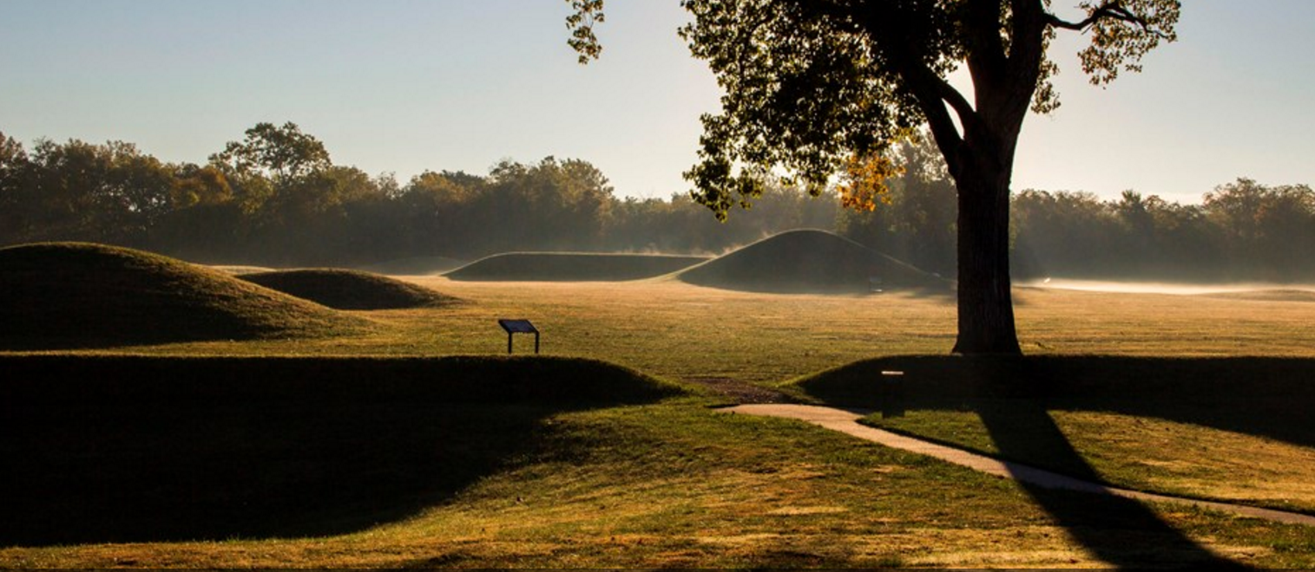
Artifacts:
What? How? Why?
Who? When? Where?
National Park Service, Hopewell Culture near Chillicothe, Ohio. (nps.gov)

Slide 36
Artifacts:
What? How? Why?
Who? When? Where?
The Adena and Hopewell Cultures are the Mound Builders of the Ohio Valley; they existed from 1000 B.C.E. to 1500 C.E. in the northeastern woodlands.
Location: from Appalachian Mountains to the eastern edge of the prairies and the Great Lakes to the Gulf of Mexico….
The Complete Idiot’s Guide to American History, p.5.

Slide 37
Who? Adena culture (800 B.C.E. – 100 C.E.), Hopewell Culture ((200 B.C.E. – 500 C.E.), and Fort Ancient culture (1000 – 1750 C.E.)
Wikipedia contributors. "Adena culture." Wikipedia, The Free Encyclopedia. Wikipedia, The Free Encyclopedia, 4 Oct. 2016. Web. 4 Oct. 2016.

Slide 38
Artifacts:
What? How? Why?
Who? When? Where?
Some mounds were built as burial grounds. Others were build to be platforms for buildings.
The Complete Idiot’s Guide to American History, p.5.

Slide 39
What’s going on?
“Virtual First Ohioans.” Ohio History Connection.

Slide 40
What’s going on? People are carrying the body of a deceased person. The shaman is wearing a bear skin showing his connection to the spiritual world. The body will be placed inside this log building along with special objects that indicate her status, and then the building will be covered in more logs and earth.
“Virtual First Ohioans.” Ohio History Connection.

Slide 41
Artifacts:
What? How? Why?
Who? When? Where?
“Virtual First Ohioans.” Ohio History Connection.

Slide 42
Artifacts:
Where? Hopewell Seip Mound
What? Copper ornament
Who? Buried with important people.
How? Copper smiths “pounded the ore into flat plates, heating the metal now and then to keep it from becoming too brittle” (“Virtual First Ohioans”).
“Virtual First Ohioans.” Ohio History Connection.

Slide 43
Artifacts:
“Virtual First Ohioans.” Ohio History Connection.

Slide 44
Artifacts:
Left to right: Knife, pipes, another knife, chlorite ornament, a hand carved of mica, canine teeth from a bear with pearls set in them, and copper ornaments….
“Virtual First Ohioans.” Ohio History Connection.

Slide 45
Copper bird claw…
“Virtual First Ohioans.” Ohio History Connection.

Slide 46
Otter pipe…
“Adena-Hopewell Artifacts.” Children of the Sun Native Culture.

Slide 47
Artifacts: Rattler Frog Pipe, 1250 C.E.
“Cahokia: America’s Forgotten City” National Geographic

Slide 48
Artifacts give hints to culture…
“Adena-Hopewell Artifacts.” Children of the Sun Native Culture.

Slide 49
Artifacts give hints to culture…
“Adena-Hopewell Artifacts.” Children of the Sun Native Culture.

Slide 50
Artifacts give hints to culture…
“Adena-Hopewell Artifacts.” Children of the Sun Native Culture.

Slide 51
Artifacts:
What? How? Why?
Who? When? Where?
National Park Service. “Effigy Mound builders.”

Slide 52
Effigy Mounds were mounds built in the shapes of “birds, bear, deer, bison, lynx, turtle, panther, or water spirit” (nps.gov)
National Park Service. “Effigy Mound builders.”

Slide 53
Serpent Mound
Wikipedia contributors. "Serpent Mound." Wikipedia, The Free Encyclopedia. Wikipedia, The Free Encyclopedia, 20 Oct. 2016. Web. 20 Oct. 2016.
The Complete Idiot’s Guide to American History, p.5.

Slide 54
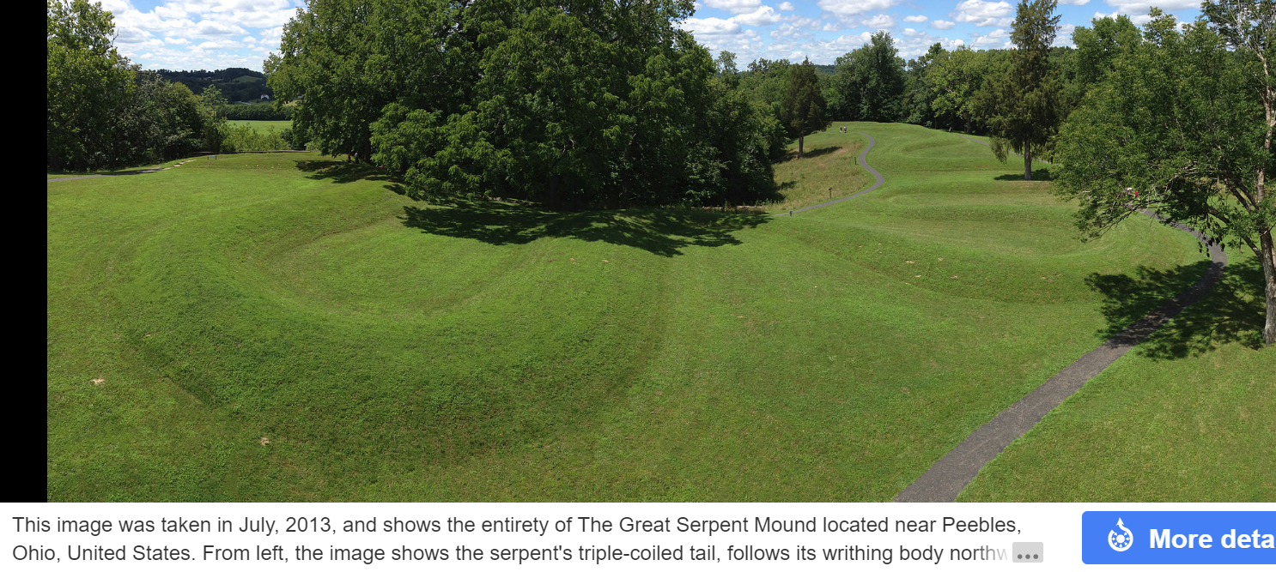
Serpent Mound
Wikipedia contributors. "Serpent Mound." Wikipedia, The Free Encyclopedia. Wikipedia, The Free Encyclopedia, 20 Oct. 2016. Web. 20 Oct. 2016.

Slide 55
Serpent Mound
Indian Country Today Media Network. “History Got it Wrong: Scientists Now Say Serpent Mound as Old as Aristotle: by Geoffrey Sea. 8/17/14.

Slide 56
Another view…
“Adena-Hopewell Artifacts.” Children of the Sun Native Culture.

Slide 57
Artifacts:
What? How? Why?
Who? When? Where?
“Monumental American Indian Architecture.” Nile of the New World. National Park Service.

Slide 58
Artifacts:
What? How? Why?
Who? When? Where?
“Cahokia: North American Mounds.” http://www.crystalinks.com/NorthAmericanMounds.html

Slide 59
Artifacts:
What? How? Why?
Who? When? Where?
“Cahokia Mounds.” http://scienceviews.com/indian/cahokia.html

Slide 60
Artifacts:
Birdman Tablet shows a man with the wings of a bird and diagonal lines which may signify a snake. The bird represents heaven, man represents the earthly realm, and the snake represents the underworld, perhaps.
“Cahokia Mounds.” http://scienceviews.com/indian/cahokia.html

Slide 61
Artifacts: Birdman Tablet
“Cahokia: America’s Forgotten City” National Geographic

Slide 62
Artifacts: Cedar Mask for a shaman, 1400 C.E.
“Cahokia: America’s Forgotten City” National Geographic

Slide 63
Artifacts:
What? How? Why?
Who? When? Where?
“Cahokia Mounds.” http://scienceviews.com/indian/cahokia.html

Slide 64
Artifacts:
What? How? Why?
Who? When? Where?
“Cahokia: America’s Forgotten City” National Geographic
Game: Two teams. One team would roll stones on ground, and other team would throw spears to predict where the stones would stop.

Slide 65
Artifacts:
What? How? Why?
Who? When? Where?
“Antler and Bone Artifacts: Cahokia Mounds State Historical Site.”

Slide 66
Artifacts:
What? How? Why?
Who? When? Where?
Martin Pate painting of “Ancient Civilizations-Forgotten Cultures.” Website: “Building the Mounds.” Indian Mounds of Mississippi. National Park Service.
The Complete Idiot’s Guide to American History, p.5.

Slide 67
Artifacts:
What? How? Why?
Who? When? Where?
“Mound Builders of Mississippi.” Mississippi Legends. .

Slide 68
Artifacts:
What? How? Why?
Who? When? Where?
The Mississippian Mound Builders along the Mississippi River also existed from 1000 B.C.E. to 1500 C.E.
Location: from Appalachian Mountains to the eastern edge of the prairies and the Great Lakes to the Gulf of Mexico….
The Complete Idiot’s Guide to American History, p.5.

Slide 69
Who?
Wikipedia contributors. "Mound Builders." Wikipedia, The Free Encyclopedia. Wikipedia, The Free Encyclopedia, 3 Nov. 2016. Web. 3 Nov. 2016.

Slide 70
Artifacts:
What?
The Mississippian Mound Builders were, in some cases, building platforms or temple mounds, and, in other cases, “rounded domes” (nps.gov) upon which an important person would live.
“Building the Mounds.” Indian Mounds of Mississippi. National Park Service.

Slide 72
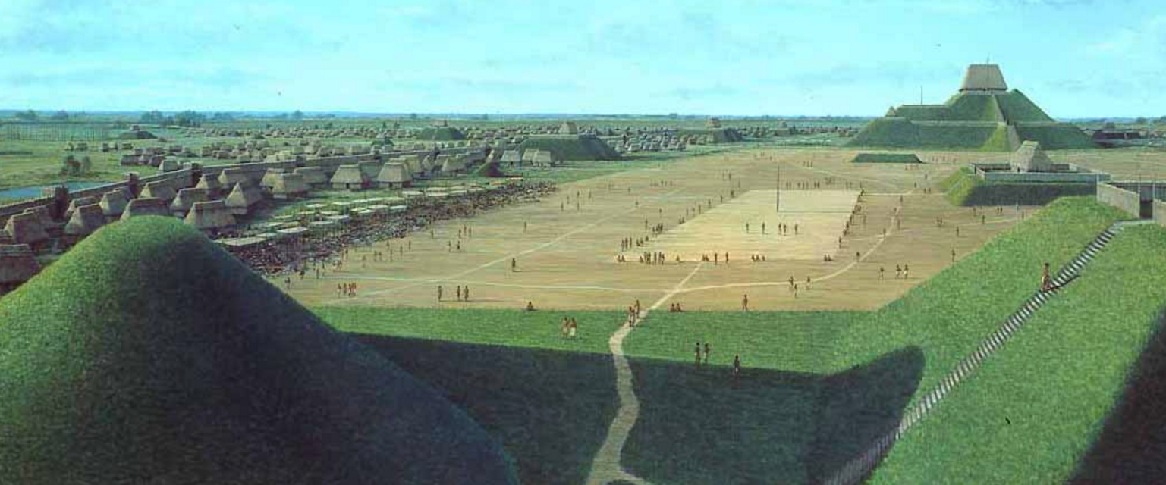
The Cahokia Mounds near St. Louis, Missouri (600-1400 C.E.). 120 earthen mounds were build in an area of 6 square miles. At its peak, the population was about 40,000 people.
“Cahokia: North American Mounds.” http://www.crystalinks.com/NorthAmericanMounds.html

Slide 73
Monk’s Mound in the Cahokia Mounds area.
“Cahokia: North American Mounds.” http://www.crystalinks.com/NorthAmericanMounds.html

Slide 74
Monk’s Mound in the Cahokia Mounds area.
“Cahokia: North American Mounds.” http://www.crystalinks.com/NorthAmericanMounds.html

Slide 75
Descendants of the Ohio River Valley Mound Builders… So many, here are a few…
The Sioux (Standing Rock, Crow Creek, and more)
The Omaha Tribe of Nebraska
Winnebago Tribe of Nebraska
National Park Service, “Effigy Mounds.”

Slide 76
Descendants of the Mississippi Valley Mound Builders…
The Natchez…
"The Mound Builders: The Poverty Point, Adena, Hopewell, and Mississippian Cultures." U*X*L Encyclopedia of Native American Tribes. . Encyclopedia.com. 20 Nov. 2016 <http://www.encyclopedia.com>.

Slide 77
Decline
Reasons for decline of theses culture vary. It happened after the arrival of the Spanish. The decline could have been due to European diseases, climate change, and the difficulty of healthfully disposing of waste in urban areas.
The Natchez may have been a direct descendent of the Mississippian Mound Builders. The Natchez fought French colonization 1729-1731. The French won and sold many of the Native Americans into slavery in the Caribbean.
"The Mound Builders: The Poverty Point, Adena, Hopewell, and Mississippian Cultures." U*X*L Encyclopedia of Native American Tribes. . Encyclopedia.com. 20 Nov. 2016 <http://www.encyclopedia.com>.

